Slide 1
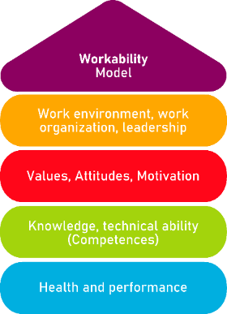
Tool 19 Mindfulness – a tool to increase concentration
Regulation of the work ability in small and micro enterprises through multimedia tools

Slide 2
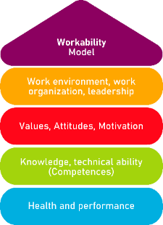
Tool 19
Description of the aim
The tool aims to train the ability to pay conscious and full attention to the present moment. Effects include improving concentration, productivity, creative thinking and effective communication.
Target Group
Employees
Benefits of the tool
The tool will allow you to increase the ability to concentrate on tasks. Its implementation will also promote empathy. Greater concentration and empathy will allow you to identify and follow priorities more clearly, to improve listening skills as well as ability to communicate more clearly and effectively, and to suffer less from the distractions so typical of today's working world. Mindfulness helps to cultivate creative thinking, to keep the mind open to incoming thoughts, to increase working memory and decrease in emotional reactivity.
How to use the tool
The tool consists of 6 main steps. Each of these focuses on a different area that together make up the practice as a whole. To make the most of the tool, we recommend to read carefully all the subsequent steps of mindfulness practice and to continue taking notes of each method while reading it. Then you will know what practices you can implement in your daily life.
Legal description – Creative Commons licensing: The materials published on the AKKU project website are classified as Open Educational Resources' (OER) and can be freely (without permission of their creators): downloaded, used, reused, copied, adapted, and shared by users, with information about the source of their origin.
The European Commission's support for the production of this publication does not constitute an endorsement of the contents, which reflect the views only of the authors, and the Commission cannot be held responsible for any use which may be made of the information contained therein.

Slide 3
Mindfulness
What it is?
Why is it necessary?
Mindfulness is a technique of meditation that helps to achieve work balance.
Today's worker, under the influence of many stimuli, is often responsible for very different tasks and too many tasks to complete. Thus, the worker is not able to maintain attention or focus on a task for a longer period of time.
Legal description – Creative Commons licensing: The materials published on the AKKU project website are classified as Open Educational Resources' (OER) and can be freely (without permission of their creators): downloaded, used, reused, copied, adapted, and shared by users, with information about the source of their origin.
The European Commission's support for the production of this publication does not constitute an endorsement of the contents, which reflect the views only of the authors, and the Commission cannot be held responsible for any use which may be made of the information contained therein.

Slide 4
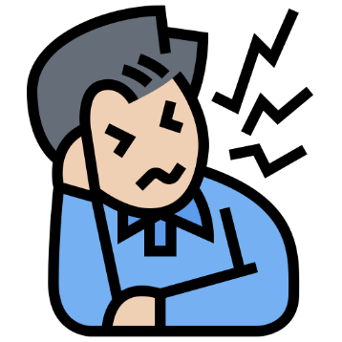
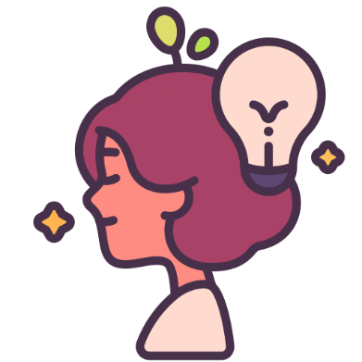
Mindfulness
Mindfulness technique trains the ability to pay conscious and full attention to the present moment.
Effects include improving concentration, productivity, creative thinking and effective communication.
How it works?
What are the effects?
MINDFULNESS
Legal description – Creative Commons licensing: The materials published on the AKKU project website are classified as Open Educational Resources' (OER) and can be freely (without permission of their creators): downloaded, used, reused, copied, adapted, and shared by users, with information about the source of their origin.
The European Commission's support for the production of this publication does not constitute an endorsement of the contents, which reflect the views only of the authors, and the Commission cannot be held responsible for any use which may be made of the information contained therein.

Slide 5
Mindfulness – 6 steps
2. Open mind
1. Concentration
3. Be here and now
6. Working memory
4. Manage emotions
5. Empathy
Legal description – Creative Commons licensing: The materials published on the AKKU project website are classified as Open Educational Resources' (OER) and can be freely (without permission of their creators): downloaded, used, reused, copied, adapted, and shared by users, with information about the source of their origin.
The European Commission's support for the production of this publication does not constitute an endorsement of the contents, which reflect the views only of the authors, and the Commission cannot be held responsible for any use which may be made of the information contained therein.

Slide 6
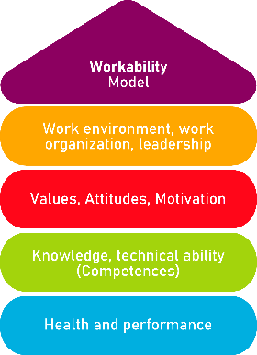
STEPS 1-2
1. Concentration
Concentration trains the mind to stay in the present moment. The ability to stay concentrated is crucial in most tasks, especially managerial and organizational tasks. You will be able to identify and follow priorities with greater clarity, suffering less from the distractions and dispersions so typical of today's working world.
2. Open mind
It focuses on opening the mind for new ideas which helps to develop divergent thinking, in the sense of breaking away from the usual way of approaching problems and from implementation patterns built up through experience. In essence, creative thinking is fostered.
Legal description – Creative Commons licensing: The materials published on the AKKU project website are classified as Open Educational Resources' (OER) and can be freely (without permission of their creators): downloaded, used, reused, copied, adapted, and shared by users, with information about the source of their origin.
The European Commission's support for the production of this publication does not constitute an endorsement of the contents, which reflect the views only of the authors, and the Commission cannot be held responsible for any use which may be made of the information contained therein.
Notes:
Picture:
https://unsplash.com/photos/pb_lF8VWaPU
- https://unsplash.com/photos/mO-uPVwGVI0

Slide 7
STEPS 3-4
3. Be here and now
4. Manage emotions
A greater ability to concentrate and empathize allows you to improve your listening skills, as well as the ability to communicate more clearly and effectively with colleagues, subordinates or supervisors. The increase in awareness and the ability to be in the "here and now" that mindfulness trains are the keys to achieving these goals.
Managing emotions, especially negative emotions such as frustration, anger, bitterness, or disappointment, can be of great help in the workplace. People who practice midfullness are able to divert their attention away from emotionally upsetting images to focus on cognitive tasks much better than people who do not practice it.
Legal description – Creative Commons licensing: The materials published on the AKKU project website are classified as Open Educational Resources' (OER) and can be freely (without permission of their creators): downloaded, used, reused, copied, adapted, and shared by users, with information about the source of their origin.
The European Commission's support for the production of this publication does not constitute an endorsement of the contents, which reflect the views only of the authors, and the Commission cannot be held responsible for any use which may be made of the information contained therein.
Notes:
Picture:
https://unsplash.com/photos/pb_lF8VWaPU
- https://unsplash.com/photos/mO-uPVwGVI0

Slide 8
STEPS 5-6
5. Empathy
It concentrates on increasing empathy which allows you to develop a deep understanding of yourself to feel good about yourself and be more willing and able to understand the feelings of others.
6. Working memory
The last step is an increase in working memory that results from meditation practice itself followed regularly for several weeks.
Legal description – Creative Commons licensing: The materials published on the AKKU project website are classified as Open Educational Resources' (OER) and can be freely (without permission of their creators): downloaded, used, reused, copied, adapted, and shared by users, with information about the source of their origin.
The European Commission's support for the production of this publication does not constitute an endorsement of the contents, which reflect the views only of the authors, and the Commission cannot be held responsible for any use which may be made of the information contained therein.
Notes:
Picture:
https://unsplash.com/photos/pb_lF8VWaPU
- https://unsplash.com/photos/mO-uPVwGVI0

Slide 9
Mindfulness
Basic meditation technique to use while practicing mindfulness
Find a comfortable place in which you feel safe and nobody will disturb you. It should be quiet and cozy.
Choose a comfortable position in which you could stay for a while. You can sit in the armchair and place your feet on the floor, or you can sit directly on the floor cross-legged, also you can just stand still. Whatever is comfortable for you.
Preparation
Set a time limit. At the beginning it would be better to choose 5 or 10-minute practices, so that your brain will get accustomed to such practice.
Legal description – Creative Commons licensing: The materials published on the AKKU project website are classified as Open Educational Resources' (OER) and can be freely (without permission of their creators): downloaded, used, reused, copied, adapted, and shared by users, with information about the source of their origin.
The European Commission's support for the production of this publication does not constitute an endorsement of the contents, which reflect the views only of the authors, and the Commission cannot be held responsible for any use which may be made of the information contained therein.

Slide 10
Mindfulness
Basic meditation technique to use while practicing mindfulness
Focus on your breath. Start observing how the air goes in and goes out.
Let’s practice for 5-10 minutes
It is normal that when you focus on your breath, your brain will start wandering, when you notice that, just try to return your attention to the breath.
When the time limit ends, take a moment and notice how your body feel, whether something has changed, what your emotions and thoughts are.
Legal description – Creative Commons licensing: The materials published on the AKKU project website are classified as Open Educational Resources' (OER) and can be freely (without permission of their creators): downloaded, used, reused, copied, adapted, and shared by users, with information about the source of their origin.
The European Commission's support for the production of this publication does not constitute an endorsement of the contents, which reflect the views only of the authors, and the Commission cannot be held responsible for any use which may be made of the information contained therein.

Slide 11
Benefits of mindfulness
Practicing mindfulness for several weeks by means of basic meditation technique will allow you to achieve several benefits, such as:
02
01
Improve concentration
Achieve work life balance
04
03
Enhance effective communication
Boost productivity and creative thinking
Legal description – Creative Commons licensing: The materials published on the AKKU project website are classified as Open Educational Resources' (OER) and can be freely (without permission of their creators): downloaded, used, reused, copied, adapted, and shared by users, with information about the source of their origin.
The European Commission's support for the production of this publication does not constitute an endorsement of the contents, which reflect the views only of the authors, and the Commission cannot be held responsible for any use which may be made of the information contained therein.

Slide 12
Action Plan
What is to be done? | How to do it ? | Cost estimation | Priority | Duration
Ex. Analysis of needs | Read the tool carefully and analyse in which area you could improve your focus | ☐ high ☐ medium ☐ low | ☐ high ☐ medium ☐ low
 |  | ☐ high ☐ medium ☐ low | ☐ high ☐ medium ☐ low
 |  | ☐ high ☐ medium ☐ low | ☐ high ☐ medium ☐ low
 |  | ☐ high ☐ medium ☐ low | ☐ high ☐ medium ☐ low
 |  | ☐ high ☐ medium ☐ low | ☐ high ☐ medium ☐ low
Legal description – Creative Commons licensing: The materials published on the AKKU project website are classified as Open Educational Resources' (OER) and can be freely (without permission of their creators): downloaded, used, reused, copied, adapted, and shared by users, with information about the source of their origin.
The European Commission's support for the production of this publication does not constitute an endorsement of the contents, which reflect the views only of the authors, and the Commission cannot be held responsible for any use which may be made of the information contained therein.

Slide 13
Thank you for your attention!
Regulation of the work ability in small and micro enterprises through multimedia tools

